Slide 1
Design of a New, Small-Scale Modular Ammonia Synthesis Process
Tora Gao, Zheng Shi, Leon Zhang
6/2/2020
ChemE 486

Slide 2
Outline
Introduction/Objective: Design a modular ammonia synthesis system (50 mtpd) for ammonia-demanding area to reduce the overall cost of ammonia
Upstream Process: Electrolysis, PSA
Downstream Process: Reactive-absorption ammonia synthesis loop
Economic Overview: Fixed capital investment, manufacturing cost, and profitability
Conclusion: Not profitable. Design should not be further pursued
Recommendation: Increase modular size, renegotiate energy cost, renegotiate equipment cost (discount on large scale order)
Notes:
Outline
Tell the audience what you are going to tell them, using a visual aid for reinforcement. This is usually an outline of the report. It is not sufficient to list the structure of the report e.g. introduction, results, discussion, conclusion. You should include a few words abstracting the contents of each section.
Early in your talk, describe the project, flowsheet, etc., in general, before getting into the details. Also early in your talk, mention the bottom-line conclusion.

Slide 3
Introduction

Slide 4
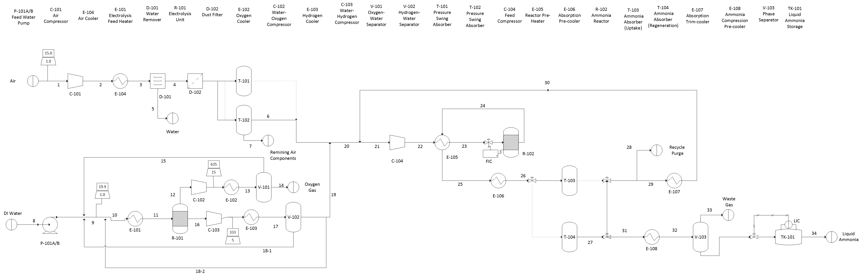
Process Flow Diagram (PFD)
Shi
Notes:
Results
Follow the outline of the results section in your written report, with a few notes to remember. First, a detailed stream flow table will not be easily seen or understood by your audience. Second, what is effectively communicated in a table in a written report may be better expressed orally using a graph. Avoid complex tables and figures with small print. These can neither be seen in the back of the room nor digested by anyone.
I suggest working through each of the major elements of your design piece-by-piece e.g. first work through the reactor information and build outward to the separation process, the heat exchanger design, recycle loops, and any waste clean-up steps.
All of the results on figures and tables in the written design report section apply to oral presentations.

Slide 5
Electrolysis
Pros:
Environmentally friendly
Potential to achieve high purity hydrogen gas
Suitable for small scale processes
Cons:
Energy-intensive, uses a lot of electricity (but we have renewable energy)
Does not scale (not an issue in our case)

Slide 6
Pressure Swing Adsorption (PSA)
Pros:
No need for air liquefication (a requirement for many other processes such cryogenic distillation)
Potential to achieve high purity nitrogen
Input is air (essentially free)
Low operating cost
Cons:
Does not scale (not an issue for our case)

Slide 7
Absorption
Used to recover ammonia product after reactor
Pros:
Help reduce operating pressure and temperature
Minimize equipment size
Good choice of absorbent could achieve high recovery rate
Cons:
Does not scale (not an issue for our case)

Slide 8
Design Discussion
Parallel Structure:
6 modules, each produces 8.9 mtpd anhydrous ammonia to meet 50 mtpd specification
More consistent and flexible
Economic of scale
Suits small scale topic
Alternatives
Non-thermal plasma (NTP) reactor for greener ammonia synthesis
Technology still at lab-bench scale and very expensive
Water-gas shift reaction for hydrogen production
Significantly increased carbon emission
Carbon emission
Equipment matches heuristics

Slide 9
Safety and Environment
Personnel Safety: high voltage electric, and high Temperature
Material Safety: nitrogen (Suffocation), hydrogen (Suffocation & Explosion), ammonia (respiratory diseases and skin Irritation)
Environmental Safety: ammonia affects aquatic live growth, leads to heavy algae growth, blocks the surface of water, and leads to deficiency of oxygen in water

Slide 10

Fixed Capital Investment (Total Grassroots Cost)
First-of-a-kind (FOAK) module cost: $12,144,000
$k_{n}=k_{1}∗n^{\log_{2}(p)}$
p = 0.8 for modular manufacturing
Module Number | Module Cost ($)
1 (FOAK) | 12,144,000
2 | 9,715,000
3 | 8,526,000
4 | 7,772,000
5 | 7,233,000
6 | 6,821,000
Total | 52,210,000
Notes:
“Economy of mass production” – help mitigate loss of economy of scale
Describes how cost of module units produced after the FOAK unit decreases because of experience
This declining cost can be represented by an experience curve which describes how the unit cost of a module decreases by a factor, p, every time the number of units produced doubles. The factor p for modular manufacturing is approximately 0.8; the experience rate is around 20% suggesting that the cost of a unit module decreases by 20% every time the number of module units’ doubles.

Slide 11
Manufacturing Costs
Annual Cost of Manufacturing without depreciation (COM_{d}): $19,081,000
Annual Anhydrous Ammonia Product Sales: $10,485,000
Notes:
${COM}_{d}=0.18{FCI}_{L}+2.76C_{OL}+1.23(C_{UT}+C_{WT}+C_{RM})$.
Negligible cost from raw materials and waste treatment because we don’t have a ton of waste, we’re sourcing air from atmosphere (free), and water for electrolysis is really cheap
Annual utility cost breakdown shows that electrolyzer/compressors/absorption towers costs the most
This is even assuming a PPA that allows us to purchase renewable electricity (from wind) at a low cost of $0.02/kW
Comparison of Comd and product revenue already shows that we’re not making any annual profit
Mainly due to large utility costs and large FCI

Slide 12
Economics Analysis
Assume:
20-year project lifetime
Construction period of one year
35% taxation rate
8% discount rate
MACRS 5-year depreciation schedule
Net present value: -89.6 million dollars
Our current process is not profitable and should not be pursued further
Notes:
Other profitability metrics (like discounted payback period and present value ratio) are unavailable because our process isn’t profitable
This negative trend in CEPCI is because COMd > revenue so we are inherently not making any annual profit.

Slide 13
Why Is Our Process Not Profitable?
Imbalance between small revenue range (small-scale process) and high capital/operating costs
Compressors/electrolyzers/absorption towers are 77.8% of FCI
$40.6 million
Loss of economy of scale most important for compressors
Electrolyzers account for 51% of utility costs
$2.97 million annually
Max annual product sales of $10,485,000 (50 mtpd capacity)
Electrolysis isn’t currently an economically viable process for hydrogen production at this scale.
Even with reduced reaction/operating pressures, loss of economy of scale is still significant for compressors
Notes:
Even at a significantly reduced reaction pressure of 30 bars, compressors still account for around half of the FCI i.e. compression is still very expensive and the loss of economy of scale is felt the most with the compressors
Biggest challenge with scaling-down haber-bosch
d

Slide 14
Conclusion
New small-scale modular design for achieving 50 mtpd of anhydrous ammonia
Meets ammonia demand in Midwest region
Take advantage of cheap renewable energy
Parallel modular manufacturing
Minimizes carbon footprint
Currently not profitable and should not be further pursued at this time

Slide 15
Recommendations
Increase module sizes and overall production rate for improved product revenue
Large demand for ammonia fertilizer in the region meets this increased supply
Mitigate loss of economy of scale
Better PPA (power purchase agreement) to lower electrical cost
Energy storage system for continuous supply of electricity
Other methods to produce hydrogen to minimize capital/operating costs
Trade off between cost and environmental impact

Slide 16
Sources
Rashid, M. M., Al Mesfer, M. K., Naseem, H., & Danish, M. (2015). Hydrogen Production by Water Electrolysis: A Review of Alkaline Water Electrolysis, PEM Water Electrolysis and High Temperature Water Electrolysis. International Journal of Engineering and Advanced Technology, 4(3)
Zeng, K., & Zhang, D. (2010). Recent progress in alkaline water electrolysis for hydrogen production and applications. Progress in Energy and Combustion Science, 36(3), 307–326. doi: 10.1016/j.pecs.2009.11.002
Palys, M., Mccormick, A., Cussler, E., & Daoutidis, P. (2018). Modeling and Optimal Design of Absorbent Enhanced Ammonia Synthesis. Processes, 6(7), 91. doi: 10.3390/pr6070091
Patel, V. S., Patel, M. J. (2014). Separation of High Purity Nitrogen from Air by Pressure Swing Adsorption on Carbon Molecular Sieves. International Journal of Engineering Research & Technology, 3(3).
Chinh, P. V., Hieu, N. T., Tien, V. D., Nguyen, T.-Y., Nguyen, H. N., Anh, N. T., & Thom, D. V. (2019). Simulation and Experimental Study of a Single Fixed-Bed Model of Nitrogen Gas Generator Working by Pressure Swing Adsorption. Processes, 7(10), 654. doi: 10.3390/pr7100654
Genovese, J., Harg, K., Paster, M., & Turner, J. (2009). Current (2009) State-of-the-Art Hydrogen Production Cost Estimate Using Water Electrolysis. Golden, CO: National Renewable Energy Laboratory.
Turton, Richard, et al. Analysis, Synthesis, and Design of Chemical Processes. 4th ed., Pearson Education International, 2012.
Schnitkey, G., Consumer Economics, & University of Illinois. (2018, September 26). Fertilizer Prices Higher for 2019 Crop • farmdoc daily. Retrieved April 13, 2020, from https://farmdocdaily.illinois.edu/2018/09/fertilizer-prices-higher-for-2019-crop.html

